Slide 1
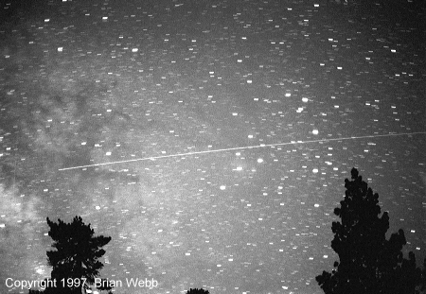
History of SETI
Is there intelligent life out there?

Slide 2

The Mission of SETI
The mission of the SETI Institute is to explore, understand and explain the origin, nature and prevalence of life in the universe.

Slide 3
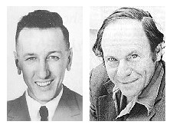
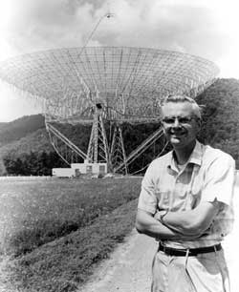
In the beginning
In 1959, Giuseppi Cocconi and Philip Morrison ,
Cornell physicists, published an article in Nature
in which they pointed out the potential for using
microwave radio to communicate between the stars.
In 1960, Frank Drake, a young radio astronomer,
conducted the first microwave radio search for
signals from other solar systems.
Starting the search for intelligent
extraterrestrial life.

Slide 4
The Soviet Union and the USA
In the 1960’s, the Soviet Union dominated the search for
extraterrestrial intelligence. The Soviets used nearly-
omni directional antennas to observe large chunks of sky, counting
on the existence of at least a few very advanced civilizations capable
of radiating enormous amounts of transmitter power.
In the early 1970’s, NASA's Ames Research Center in Mountain View,
California began a comprehensive study known as Project
Cyclops. The Cyclops report provided an analysis of SETI
science and technology issues that is the
foundation upon which much
subsequent work is based.

Slide 5
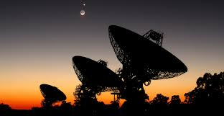
The Search
By the late 1970’s, SETI programs had been established at
NASA's Ames Research Center and at the Jet Propulsion
Laboratory (JPL) in Pasadena, California. These groups arrived
at a dual-mode strategy for a large-scale SETI project. Ames
would examine 1,000 Sun-like stars in a targeted search,
capable of detecting weak or sporadic signals. JPL would
systematically sweep all directions in a Sky Survey.

Slide 6
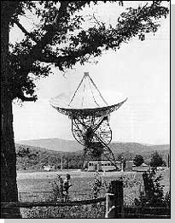
SETI and NASA
November 20, 1984, The SETI Institute was born. John
Billingham, Chief of Life Sciences at NASA Ames Research
Center, had been nurturing NASA’s interest in SETI since he
stewarded the 1971 publication of Project Cyclops, edited by
Bernard M. (Barney) Oliver.
In 1988, NASA Headquarters formally adopted the
dual-mode strategy for a large-scale SETI projects,
and funded the program.
In 1992, the observations began.
Within a year, Congress terminated
funding.

Slide 7
What Now?
With NASA no longer involved, both researchers and interested
members of the public saw a diminished chance to answer,
within their lifetimes, the profound question, “Is there
intelligent life out there?”. The SETI institute decided to
continue their mission to answer that question and more with
private funding.

Slide 8
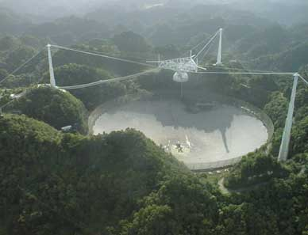
Project Phoenix
Project Phoenix is the successor to the ambitious NASA SETI program which was cancelled by the American Congress in 1993. It is operated by the SETI Institute, it is the world's most sensitive and comprehensive search for extraterrestrial intelligence. Its aim is to detect the presence of other civilizations by listening for radio signals that are either being deliberately beamed our way, or are inadvertently transmitted from another planet.

Slide 9
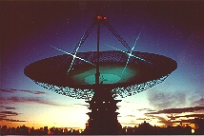
Project Phoenix Continued
Project Phoenix began observations in February 1995 using the Parkes 64m radio telescope in New South Wales, Australia along with the smaller Mopra 22m Antenna some 125 miles to its north to provide an immediate confirmation of any extraterrestrial signals. The Parkes telescope is the largest radio telescope in the Southern Hemisphere so is the natural choice for making observations of those regions of the sky that are not visible with larger telescopes in the northern hemisphere. Phoenix is using a targeted search strategy so, rather than scanning the whole sky, monitors the positions of nearby, sun-like stars. It is on planets in orbit around similar long lived, but relatively bright, stars such as our Sun that it is expected that other life forms would be most
likely expected to evolve. Around 1000 stars within a distance of 200 light-years have been selected for observation by Project Phoenix.

Slide 10
What Are We Listening For?
We obviously do not know at what frequency any extraterrestrial signals might be being transmitted, but there is a wide band of frequencies between 1,000 and 10,000 MHz where the background noise, for example from our Galaxy, is a minimum. Mobile phones operate at the lower end of this band and Satellite Television at the other. The most common element in the Universe, Hydrogen emits at a frequency of 1420 Mhz whilst Hydrogen bonded to a single Oxygen atom to form the radical OH radiates at frequencies near 1600 Mhz. This defines a smaller band which, as H and OH together form water, is known as the "Water Hole". Perhaps this would be chosen by others wishing to communicate with us.

Slide 11
ET Phone Home
To scan such a broad band in the same way as one tunes across the band of an FM radio would be a very slow proces. This is particulary so as we would expect that very narrowband signals, like morse code, would be used. Such signals are much easier to detect over long distances than more complex transmissions such as TV signals. Thus a receiver with millions of channels operating simultaneously is used to step across the band and up to two billion channels are examined for each star.
This is beyond the capability of any human and so the "listening" is done by computer. The computer system automatically eliminates known sources of local interference either from the ground or from the increasing number of satellites in orbit around the earth. Should any signal pass this scrutiny, a procedure is automatically initiated to either confirm or exclude the signal as having an extraterrestrial origin.

Slide 12
What’s Happening Now
Following the observations in the Southern Hemisphere, Project Phoenix has made observations using the 140ft antenna at Green Bank in West Virginia in conjunction with a smaller antenna at Woodbury just south of Atlanta. In June this year the equipment from Green bank was shipped to Arecibo in Puerto Rico, and that from Woodbury to Jodrell Bank. Initial test observations were carried out with the 76m Lovell radio telescope in mid July in readiness for the start of the September observations.

Slide 13
The End

