Slide 1
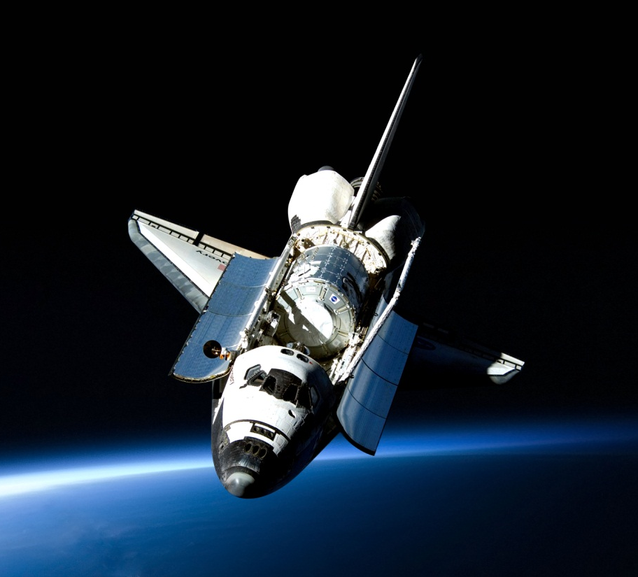
Reasons for Space Exploration

Slide 2
Scientific Discovery
Curiosity
Understanding the Universe
Answering the big questions

Slide 3
Discovery of new species
Medicinal plants and animals
Plants that can grow in harsh environments
New food sources

Slide 4
Colonization
Long- terms survival
More living space for our species
Escape from war, persecution, and poor living conditions

Slide 5
Finding New Resources
Food sources
Fuel and energy sources
New elements and materials

Slide 6
Search for Intelligent Life
New technology
New medicines
Discovery of alien cultures

Slide 7
International Collaboration
Space Stations
Sharing of resources
Sharing of ideas

Slide 8
National Security
To be the first and the best to do something
To know what we may be up against
Economic benefits

